Slide 1

Applying Machine Learning Techniques to Generate Fantasy Football Player Predictions
The goal of this project is to use NFL player statistics from past games to predict future game performance for Fantasy Football contests.
To create a tool that can guide decisions on which NFL players to use in the Fantasy Football leagues, whether on the starting lineups or ranking priorities on the waiver wires.
Jessica Arket - 11/20/2023

Slide 2
Background
Fantasy football is a game in which the participants serve as owners and general managers of virtual professional American football teams. The competitors select their rosters by participating in a draft in which all relevant National Football League players are available.
Following the draft, each week the virtual manager selects their players to play in the starting lineup or to sit on their bench. Throughout the season the lineup needs to be adjusted to account for bye weeks, poor performance and injuries.
Waiver wires are when new players get selected to play on the virtual teams. How do new players get prioritized? They do so by a ranking, which can be based on a combination of sportscaster advice, rankings and tribal knowledge.

Slide 3

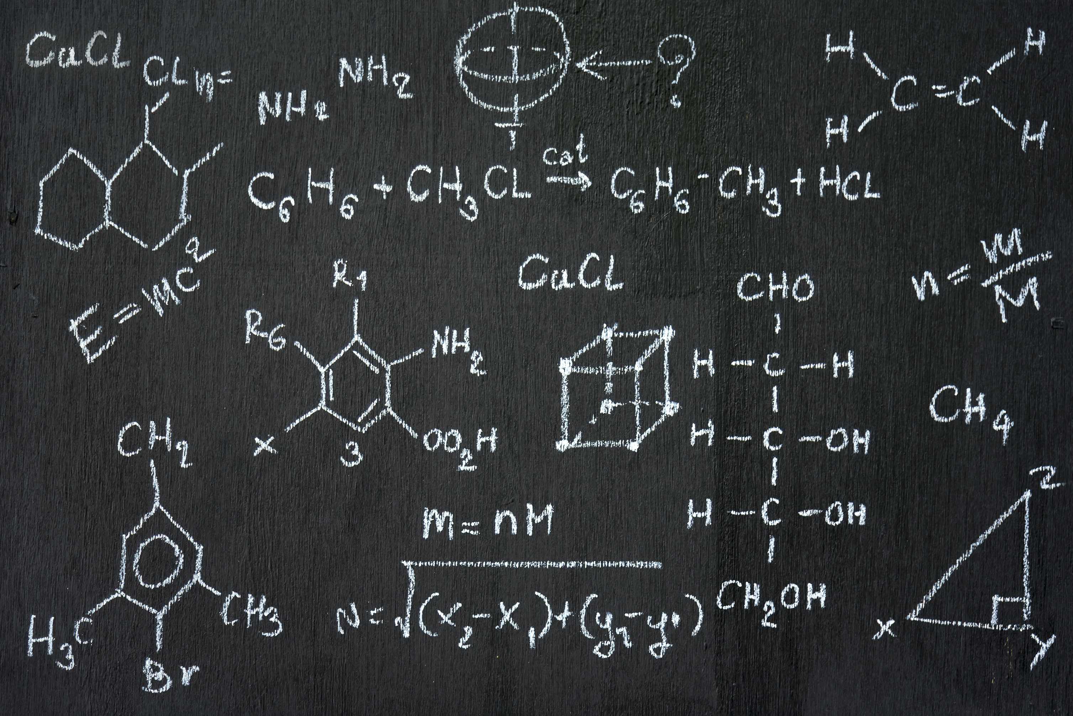

Why I chose this topic:
Math Major
Professional Data Scientist
Social Environment

Slide 4
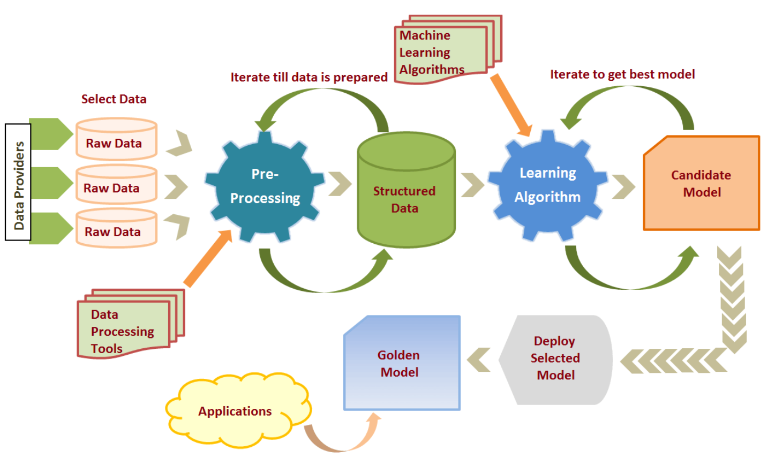
Data Science Development Process
Data Prep /
Feature Engineering
Model Building - Train/Test
Acquire/ Analyze Data
User Interface
Generate Predictions /
Inference

Slide 5
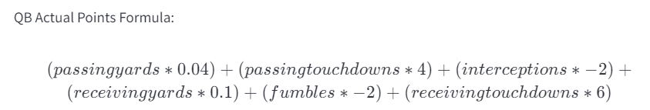
Development Process Applied to Generate NFL Player Predictions
Data Acquisition/Analysis: Download player Stats at the end of each week. Join the data with the previous weekly stats.
(Can also include Analyze Data, reinspecting for changes, quality issues, etc.)
Feature Engineering: Calculate Cumulative Sum for each player statistic.
Model Building: Train/Test Model Using newest acquired data
Inference: Generate forecasted stats for the next week.
Decompose into raw stats.
Calculate forecasted Fantasy points using player formulas.
Deployment: (Aspirational) Deploy final model predictions into format for other users to interact with.

Slide 6
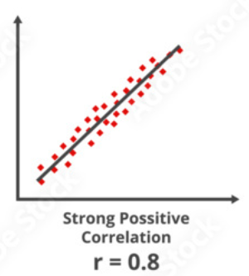
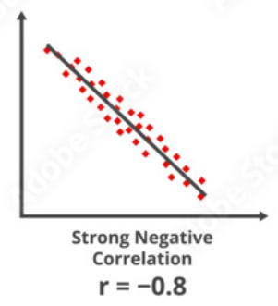
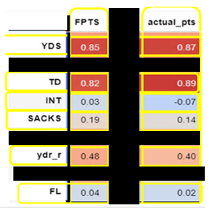
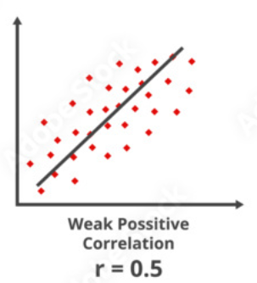
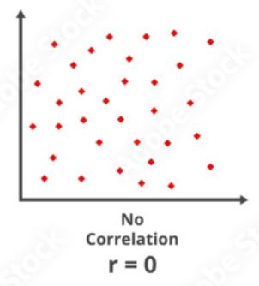




Data Acquisition & Data Analysis: Correlations between KPIs and Fantasy Points
Correlation Key:
Correlation Matrix for QB
KPIs
FantasyPros
ESPN
Key:
YDS = Passing Yards
TD = Touchdowns
INT = Interceptions
SACKS= Quarterback is tackled by the defense
Ydr_r = Receiving Yards
FL = Fumbles Lost
FPTS = FantasyPros.com Total Score
actual_pts = Actual Score of the players as per ESPN.com
Images source

Slide 7
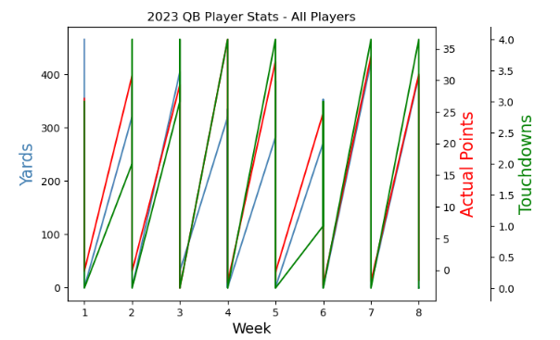
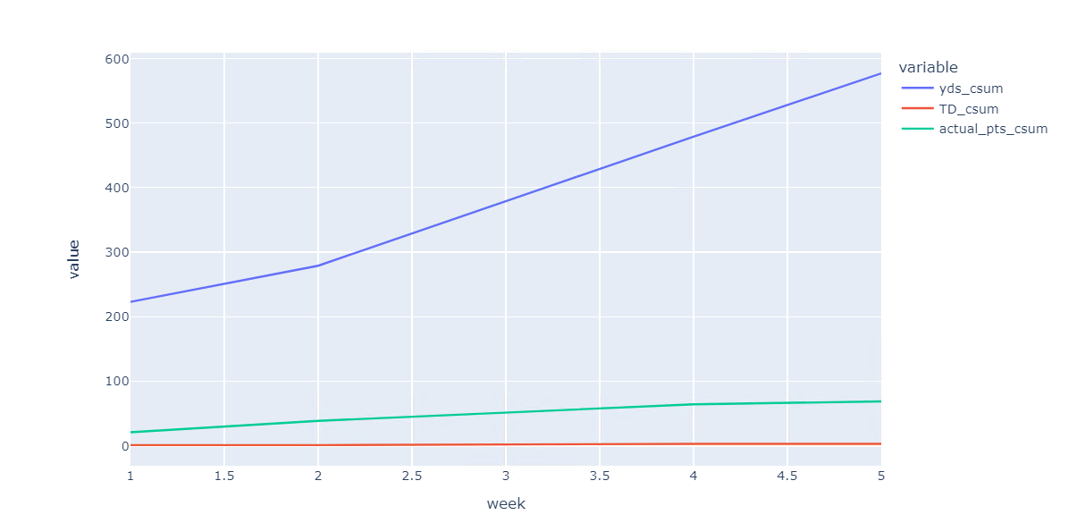
Pre-processing & Feature Engineering
Transformation of raw data into relevant variables.
The goal of pre-processing and feature engineering is to improve the performance of machine learning (ML) algorithms.
How this concept was applied to the project: Create cumulative sum of statistics for better accuracy in forecasting of player stats

Slide 8
ML Models Tested & Rated Performance
Purpose | Model | Feasibility | Performance*
Smoothing | Holt-Winters Exponential- Smoothing | Worked as expected – similar results to cumulative sum | Smoothed inputs to the model
Determining Stationarity | Augmented Dickey-Fuller Test | Worked as expected – Test for stationarity | Helpful to determine if trends are time dependent
Forecasting | Holt-Winters Simple Exponential Smoothing | Did not perform well, but room for optimization | AIC: 2707
Forecasting | ARIMA | Used Auto ARIMA for parameter optimization & performed well | Possible benefit over long term data acquisition. AIC=36.989 - 3354
Forecasting | SARIMA | Did not perform well, since no seasonality | RMSE: 1421, AIC: 3353 - 4636
Forecasting | Holt’s Linear Trend Method | Has potential, but so far has not performed as good as ARIMA | Bias against spikes in performant stats, but performed well on smoothed data. AIC: 93.204
*(AIC) is an estimator of prediction error and thereby relative quality of statistical models for a given set of data.

Slide 9
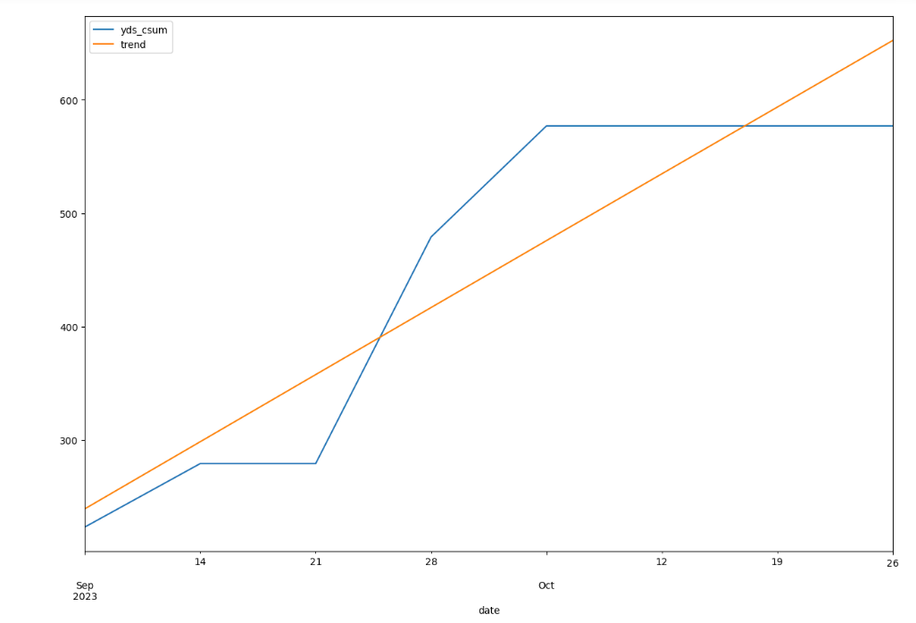
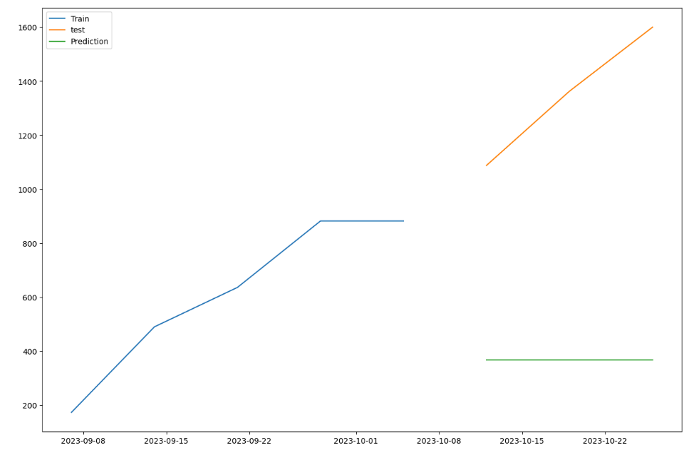
Inference & Model Evaluation
Use the model to generate predictions on specific player statistics, for example Passing Yards.
Evaluate the model’s ability to handle previously unseen data

Slide 10
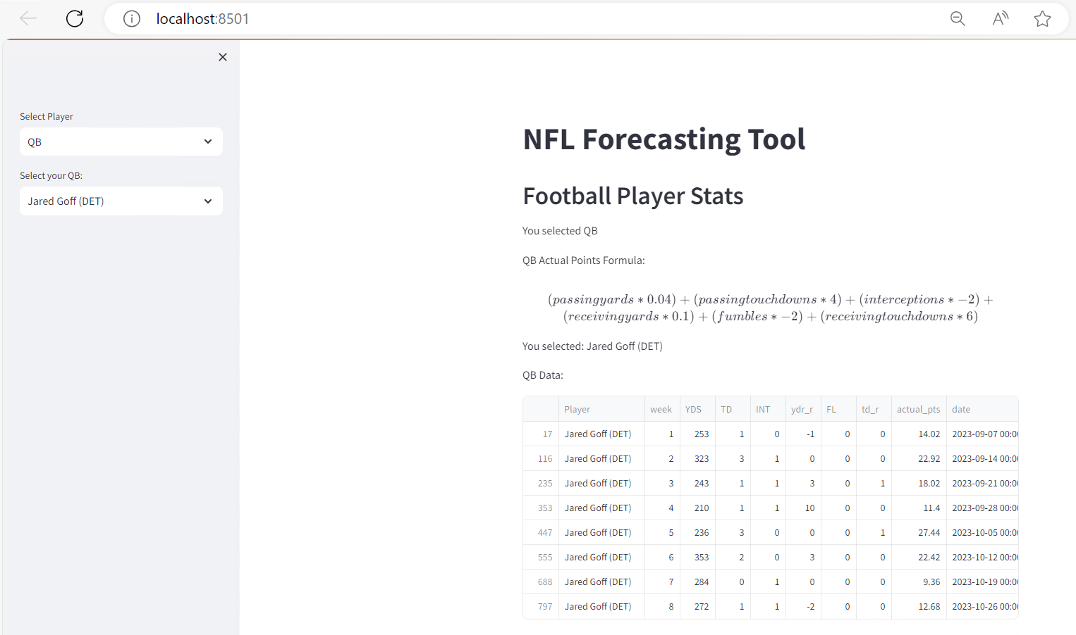
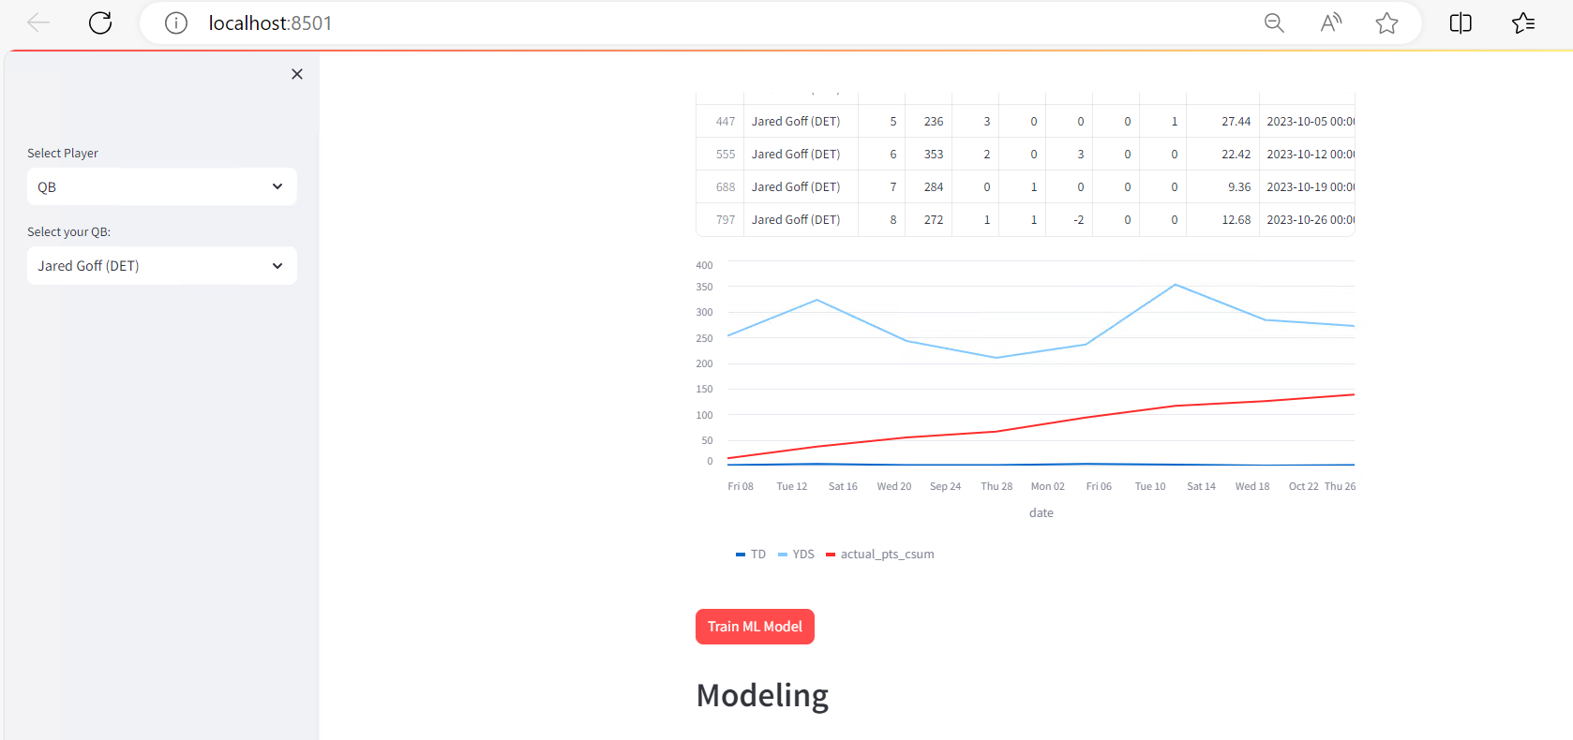
Deployment to User Interface
Makes the data & models more accessible
Streamlit python package - enables website creation w/o html experience
Users can select a player type and forecast a specific players’ future points
Adding the ARIMA models allow the models to be rebuilt each week and can be used to generate predictions & create new rankings.

Slide 11

Data Issues & Challenges
Injuries
Ranges from very hard to impossible to predict
Can happen to great players with no previous history of injuries
Turf vs grass theory – not tested (some propose turf should be banned)
Short Term Data
Is not efficient for modeling (normally forecast models require 1 year
of data to be accurate)
BYE weeks introduce inconsistencies
Long Term Data
Not necessarily representative season-to-season due to changes in coach, team dynamics, skill progression, etc.
Other Considerations
Variables associated with environment at the time of play are not considered (temp/humidity, indoor vs outdoor stadium, etc.)
Missing coaching strategy, actual plays, who will be on the field handling the ball during game day ahead of time

